Slide 1


COVID-19 CASE PREDICTION USING REGRESSION
Forecasting Future Cases with Historical Data
Group no. 02
Rajat Sharma Roll no. 05
Ranjan Kumar Roll no. 07
Rohit Parashar Roll no. 12
Shashi Ranjan Roll no. 25
Shivam Kr. Singh Roll no. 30
Sunny Kumar Roll no. 49

Slide 2
WHAT IS THE PROBLEM?
The COVID-19 pandemic caused widespread disruption globally. Predicting future case numbers can help healthcare systems prepare and respond effectively.
Goal of the project:
Forecast daily COVID-19 cases using machine learning regression models.
Visualize actual vs predicted trends.
The COVID-19 pandemic has affected millions globally.
Forecasting daily deaths helps in resource planning and public health readiness.
Our goal: Use historical data to predict future COVID-19 daily deaths using time-series regression techniques.

Slide 3
Methodology
Data Collection
Dataset containing COVID-19 patient data with death dates.
Preprocessing:
Removed invalid or missing dates
Focused on confirmed COVID-19 cases (CLASIFFICATION_FINAL values 1, 2, 3).
Data Aggregation:
Grouped death dates to get daily death counts.
Visualization:
Plotted deaths per day to observe trends.
Linear Regression
Used Linear Regression for future prediction.
Trained the model and forecasted for the next 10 days.

Slide 4

Objectives
1. Analyze Historical Data
Study past COVID-19 case trends to identify patterns, spikes, and seasonality in daily confirmed cases.
2. Apply Regression Models
Use regression-based time-series techniques (e.g., Linear Regression) to forecast future case numbers based on historical data.
3. Evaluate Model Performance
Assess model accuracy using metrics like Mean Absolute Error (MAE), Root Mean Squared Error (RMSE), and R-squared (R²) score.
4. Visualize Trends
Create clear visualizations of actual vs. predicted cases to support decision-making in public health and policy planning.

Slide 5

Dataset Overview
1. Data Sources
The dataset is collected from reliable sources such as Johns Hopkins University, the World Health Organization (WHO), and Kaggle COVID-19 datasets.
2. Key Features
Includes important attributes like Date, Country/Region, Confirmed Cases, Recovered Cases, and Deaths.
3. Project Focus
The analysis specifically focuses on daily confirmed COVID-19 cases to understand and forecast the spread of the virus over time.

Slide 6
Code Overview
import zipfile
import pandas as pd
import numpy as np
import matplotlib.pyplot as plt
from sklearn.linear_model import LinearRegression
import os
# STEP 1: Extract ZIP file
zip_file_path = '/content/covid.zip'
extract_to = 'covid_data'
with zipfile.ZipFile(zip_file_path, 'r') as zip_ref:
zip_ref.extractall(extract_to)
# STEP 2: Load India data from the convenient dataset
file_path = os.path.join(extract_to, 'CONVENIENT_global_confirmed_cases.csv')
df = pd.read_csv(file_path)
# STEP 3: Clean data
df = df.drop(index=0) # remove header row inside data
df = df.rename(columns={"Country/Region": "Date"})
df['Date'] = pd.to_datetime(df['Date']) # convert to datetime
india_df = df[['Date', 'India']].copy()
india_df['India'] = india_df['India'].astype(float)
# STEP 4: Feature engineering
india_df['Day'] = (india_df['Date'] - india_df['Date'].min()).dt.days
# STEP 5: Train/test split
train = india_df[:-30]
test = india_df[-30:]
.

Slide 7
# STEP 6: Linear Regression model
model = LinearRegression()
model.fit(train[['Day']], train['India'])
test['Predicted'] = model.predict(test[['Day']])
# STEP 7: Forecast next 30 days
future_days = 30
last_day = india_df['Day'].max()
future = pd.DataFrame({'Day': range(last_day + 1, last_day + 1 + future_days)})
future['Predicted'] = model.predict(future[['Day']])
future['Date'] = india_df['Date'].max() + pd.to_timedelta(future['Day'] - last_day, unit='D')
# STEP 8: Plot the results
plt.figure(figsize=(12, 6))
plt.plot(india_df['Date'], india_df['India'], label='Actual')
plt.plot(test['Date'], test['Predicted'], label='Test Prediction', linestyle='--')
plt.plot(future['Date'], future['Predicted'], label='Future Forecast', linestyle='--')
plt.xlabel('Date')
plt.ylabel('Cumulative COVID-19 Cases')
plt.title(' COVID-19 Case Forecast (Linear Regression)')
plt.legend()
plt.grid(True)
plt.tight_layout()
plt.show()

Slide 8
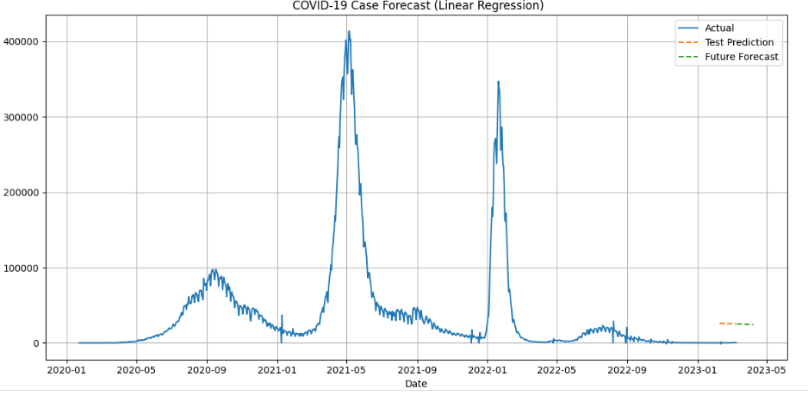
OUTPUT

Slide 9

Interpretation
Trend Observation
The model reveals a clear increasing or decreasing pattern in daily COVID-19 deaths, depending on the region and time period analyzed.
Predictive Insight
The forecast helps anticipate how fatalities may evolve in the coming days, offering a glimpse into short-term pandemic dynamics.
Can be helpful for hospitals, policy makers, etc.

Slide 10
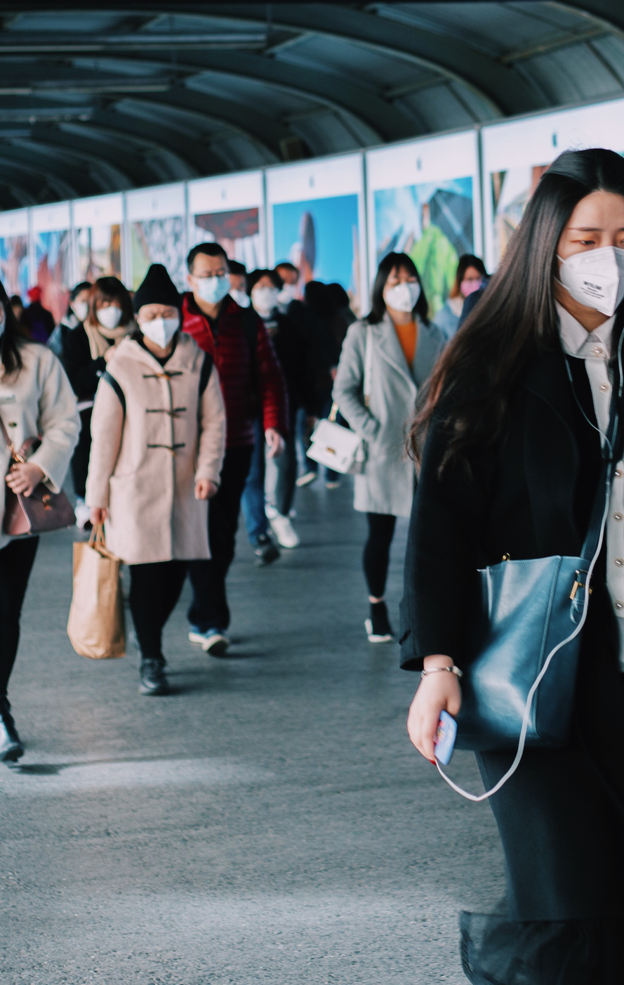
Tools and Libraries
Technologies Used
Python
Pandas
Matplotlib
Linear Model
Linear Regression
Google Colab

Slide 11

References and Credits
Dataset: [Source of "Covid Data.csv" — e.g., Kaggle or institution provided]
Libraries: pandas, matplotlib, statsmodels
Code/Help: Guidance from AbhishekSir.
Websites: Chatgpt

Slide 12
THANK YOU

